Slide 1
Factory Pattern
Design Patterns
Howard Zhou
Longan team

Slide 2
The Factory Tour
A very simple factory
Factory Method
Abstract Factory

Slide 3
Motivating Example
Consider factories when:
Unsure which concrete implementation of an interface I want to return
Creation should be separated from representation of an object
Lots of if/else blocks when deciding which concrete class to create
Switch statements when deciding which concrete class to create

Slide 4
Demo
https://app.pluralsight.com/player?course=patterns-library&author=david-starr&name=pattern-factories&clip=2&mode=live

Slide 5
Intent
Separate object creation from the decision of which object to create
Add new classed and functionality without breaking OCP
Factory-produced objects
Factories themselves
Store which object to create outside of the database
In a database
In configuration

Slide 6
Simple Factory
Encapsulate object creation
Allows for late-bound decisions regarding instantiation
Configuration-based
Other persistent storage
Input or other dynamic data
Caller class know what concrete factory it needs

Slide 7
Demo
https://app.pluralsight.com/player?course=patterns-library&author=david-starr&name=pattern-factories&clip=5&mode=live

Slide 8
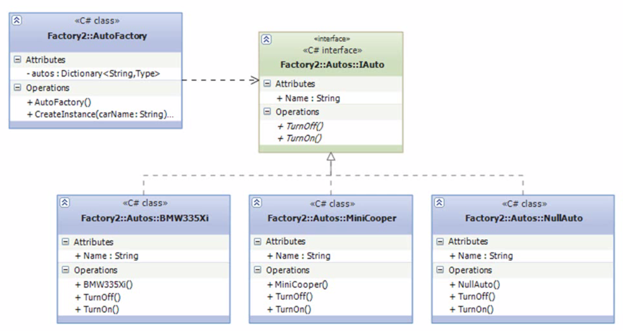
Simple factory

Slide 9
Factory Method
“Define an interface for creating an object, but let the subclasses decide which class to instantiate. Factory Method lets a class defer instantiation to subclasses.” --Design Patterns
Adds an interface to the factory itself from Simple Factory
Defers object creation to multiple factories that share an interface
Derived classes implement or override the factory method of the base

Slide 10
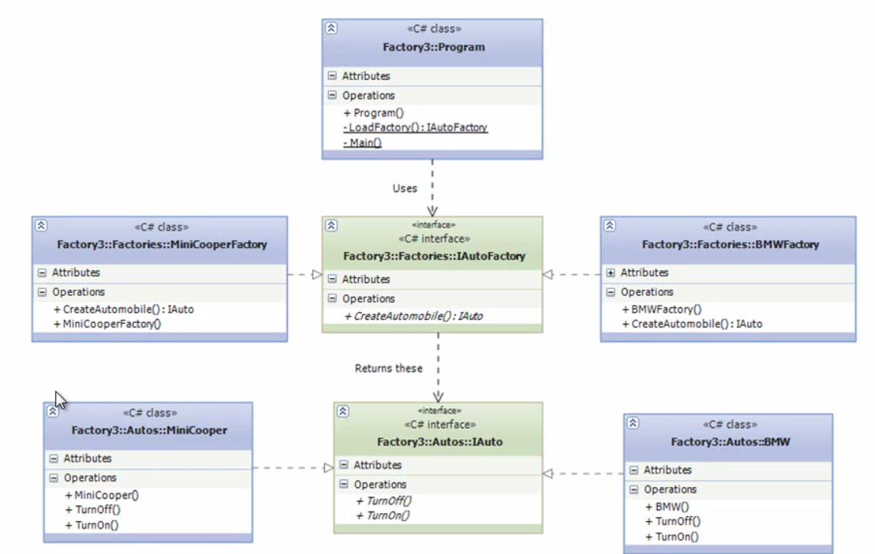
Structure

Slide 11
Demo
https://app.pluralsight.com/player?course=patterns-library&author=david-starr&name=pattern-factories&clip=8&mode=live

Slide 12
Advantages & Disadvantages
Factory Method
Advantages
Eliminate references to concrete classes
Factories
Objects created by factories
Factories can be inherited to provide even more specialized object creation
Rules for object initialization is centralized
Disadvantages
May need to create a factory just to get a concrete class delivered
The inheritance hierarchy gets deeper with coupling between concrete factories and created classes

Slide 13
Abstract Factory
Provide an interface for creating families of related or dependent objects without specifying their concrete classes.
– Design Patterns
Factories create different type of concrete objects(products)
A Factory now represents a “family” of objects that it can create
Factories may have more than one factory method

Slide 14
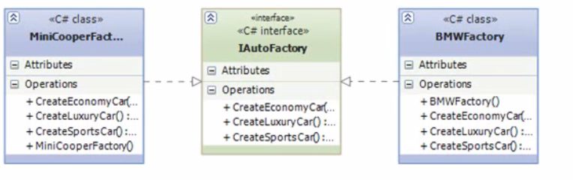
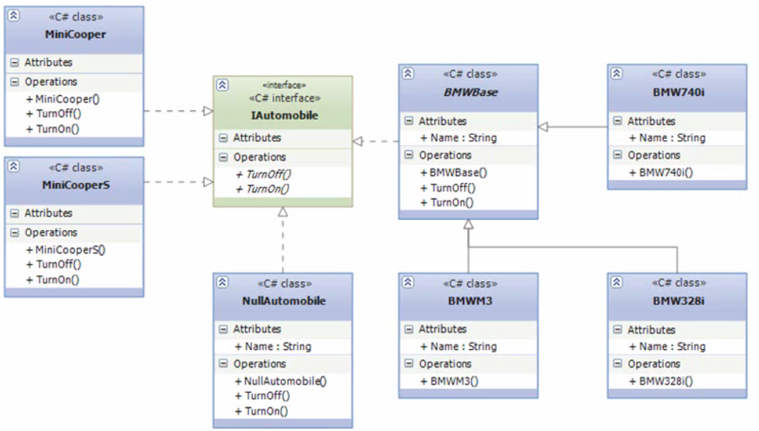
Abstract Factory

Slide 15
Demo
https://app.pluralsight.com/player?course=patterns-library&author=david-starr&name=pattern-factories&clip=11&mode=live

Slide 16
Consequences
Add new factories and classes without breaking OCP
Defer choosing classes to classes that specialize in making that decision
Using private or internal constructors hides direct construction with the new keyword

Slide 17
Demo
https://app.pluralsight.com/player?course=patterns-library&author=david-starr&name=pattern-factories&clip=13&mode=live

Slide 18
Related Materials
Other Creational patterns
Singleton
Builder
Object Pool
Prototype
Related Subjects
nullObject
Open Close Principle

Slide 19
Summary
Varying levels of sophistication support different scenarios
Factory Method
A base class or interface defines the creation method
Subclasses implement the creation method in different ways
Abstract Factory
All the attributes of Factory Method
Concrete factory classes may return various objects from a “family” of objects
Factories in .NET commonly make use of reflection

